Slide 1
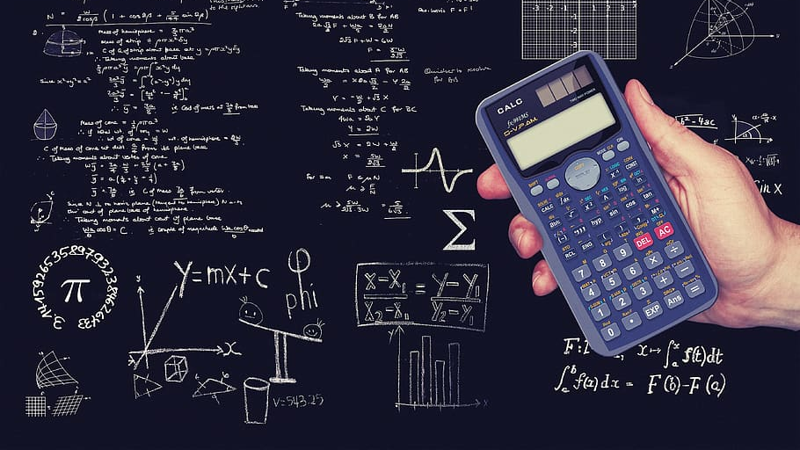

MY Quick Calculator
Intern/Data Analyst: Next Hikes IT Solutions Project date: 31st Aug 2025 Presented by: Sonal Gaikwad

Slide 2

Introduction
In this project,I created a calculator where the user can perform the basic arithmetic operations like addition,subtraction,multiplication,and division. I used Tkinter to build a graphical user interface that is easy to use.

Slide 3
Objectives
1.To create a graphical calculator
2.To implement basic math operations
3.To add percentage %,and decimal .
4.To learn and apply the Tkinter library practically

Slide 4
Tools and Technology :
I used the Python programming language because it is a good language for beginners and is also easy to understand. I created graphical buttons and an entry area using Tkinter ,I wrote the code in the VS Code IDE and saved my code on GitHub.
Design and Layout :
I created the layout of the calculator using the grid method, where the buttons are arranged in rows and columns. The entry box displays the expression and the result to the user.

Slide 5
Functionality
Each button press adds the corresponding character to the expression.The”C”button clears the screen.The “=“ button calculates the result manually by parsing the expression . The percentage button divides the number by 100 and the decimal button allows floting point numbers.

Slide 6
This is my button creation code, in which each button is placed using the grid. The calculate function returns the expression when pressed

Slide 7
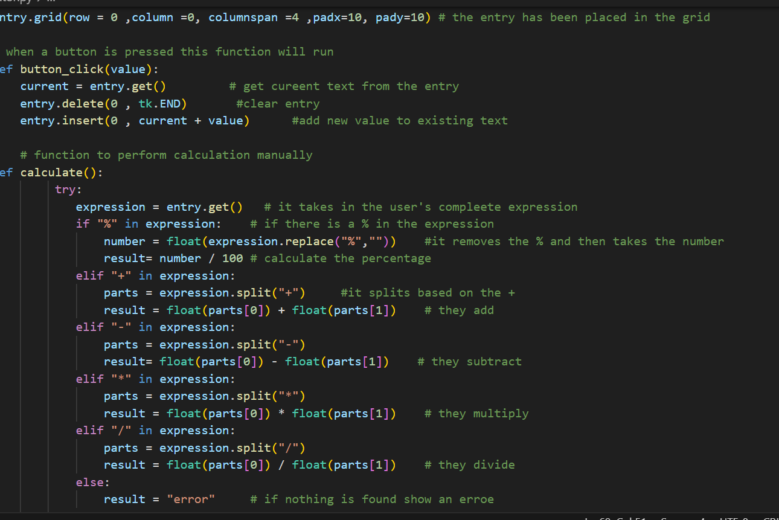

Slide 8
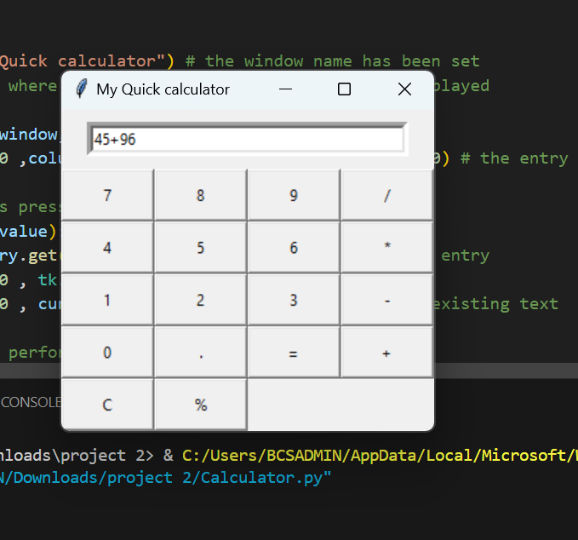
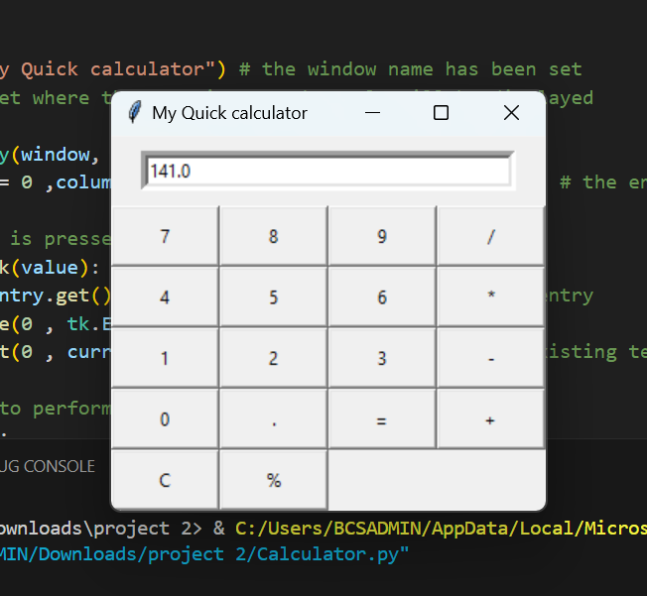
This is my running calculator.As you can see,If entr 45+96 the result is 141 correctly gives

Slide 9
Conclusion
My project was successful and fully functional. This improved my programming and GUI skills

Slide 10

Thank You

